Slide 1
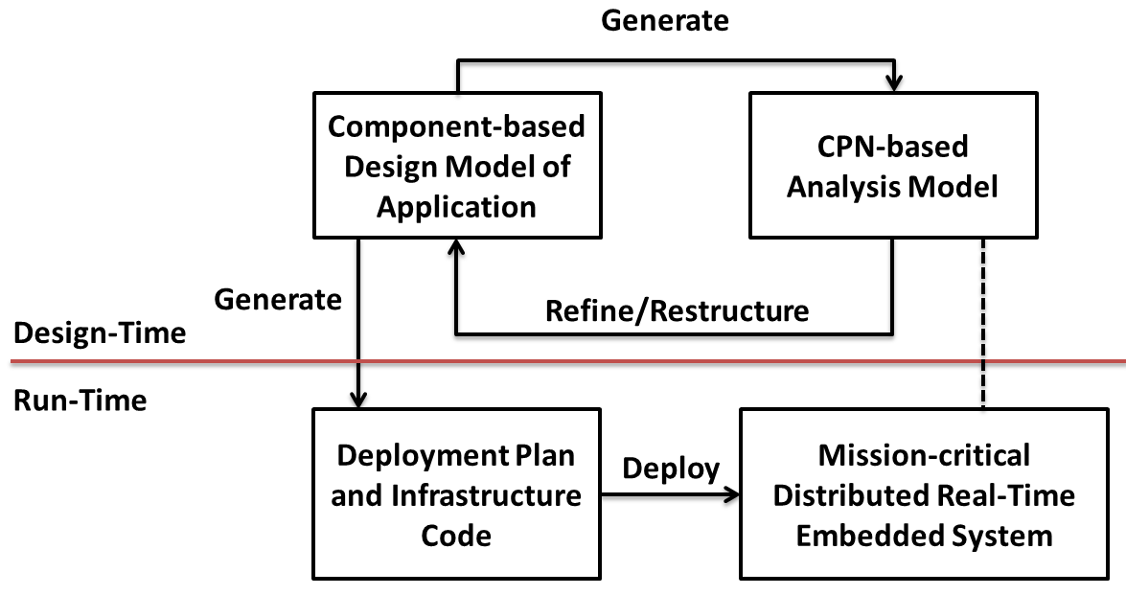
models

Slide 2
Requirements Analysis
analyze requirements
design system
refine &
restructure
Software Evolution
System Design and Specification
implement
features
System-wide Testing for Errors
Implement Software Components
System Integration and Deployment
deploy &
test system
integrate
components

